Slide 1


MY PRESENTATION
AMITABH
UPS
AMITABH
AMITABH

Slide 2
CONTENT
UPSYSTEM
MAJOR ROLES OF UPS
APPLICATIONS OF UPS INCLUDES
TYPES OF UPS
OFF LINE UPS
LINE INTERATIVE UPS
UPS FAILURE IS A MAJOR CAUSE OF DATA CENTER DOWNTIME
PREVENT DATA LOSS
AVOID HARD SHOUTDOWN
BENEFITS OF AN UNINTERRPTIBLE S POWER SUPPLY

Slide 3
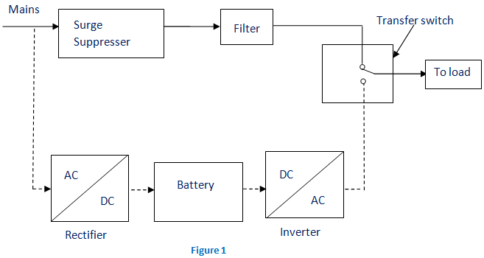
UPS SYSTEMS
(Uninterruptible power supply) A device that provides battery backup when the electrical power fails or drops to an unacceptable voltage level. Small UPS systems provide for a few minutes, enough to power down the computer in an orderly manner, while larger systems have enough battery for several hours.

Slide 4
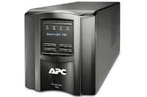
MAJOR ROLES OF UPS
Whether it is data for healthcare services,24/7 banking , or order processing, data is vital to your business. You have invested in the networks and systems that manage and store that data, and any interruption in the power supply can be devastating
When there is any failure in main power source, the UPS will supply the power for a short time. This is that prime role of ups. In addition to that, it can able to correct some general power problems related to utility services in varying degrees. The problems that can be corrected are voltage spike (sustained over voltage), Noise, Quick reduction in input voltage, Harmonic distortion and the instability of frequency in mains.

Slide 5

APPLICATIONS OF A UPS INCLUDES:-
Data centers
Industries
Telecommunications
Healthcare:hospitals,clinics and retirement homes
Banks and insurance
Some special projects (events)

Slide 6
TYPES OF UPS
Generally, the ups system is categorised into
On –line UPS,
Off –line UPS and
Line interactive UPS
Other designs includes standby on –line hybrid, standby- Ferro, Delta conversion on-line etc.

Slide 7

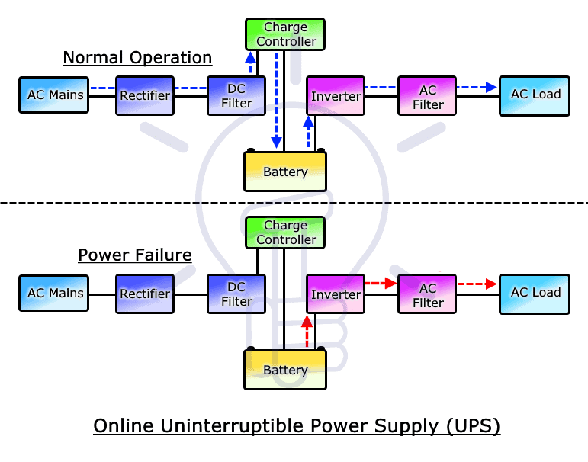
ON -LINE UPS
The online ups is a type of UPS that supplies power to the AC load through the rectifier and inverter combo in normal operation and uses an inverter to supply AC power during a power failure. Therefore, the output supply always stays on ON and there is no need for switching

Slide 8

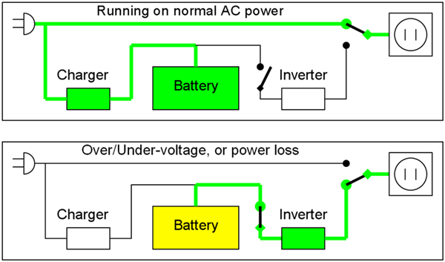
OFF-LINE UPS
Offline UPS, sometimes described as standby power supply (SPS) are systems where the load is fed directly from the raw mains during normal operations instead of the inverter outputs.

Slide 9

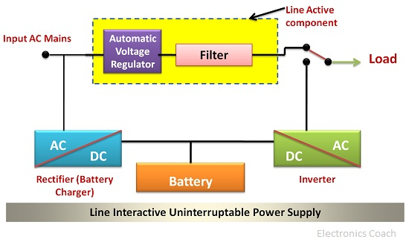
LINE INTERACTIVE UPS
A line – interactive UPS maintains the inverter in line and redirects the battery's DC current path from the normal charging mode to suppling current when power is lost. In this design, the battery-to-AC power inverter is always connected to the output of the UPS

Slide 10
UPS FAILURE IS A MAJOR CAUSE OF DATA CENTER DOWNTIME
In a recent survey released by Emerson Networking power. PS battery failure was found to be a leading source of data center downtime. A rather remarkable 65% of data center mangers survey saw UPS failure as the largest cause of data center downtime.

Slide 11
AVOID HARD SHUTDOWNS
A hard shutdown can not only mean lost data, but in some cases can lead to equipment damage or corrupted configuration, leading to more downtime, maintenance and repair costs. A UPS system is crucial to minimize the stress a hard shutdown causes on your electronic equipment
While it is impossible for commercial power companies to guarantee 100% uptime on their services, a data center can keep things running by using an uninterruptible power supply, or “UPS” for short.

Slide 12

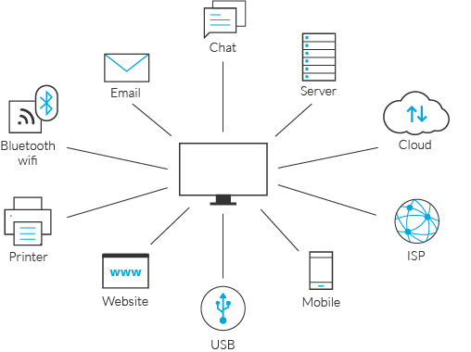
PREVENT DATA LOSS
Keep your computer clean and dust-fee.
If your PC gets hot, take it apart and clean it .
Save and backup your files regularly, to multiple locations with encryption.
Create an image backup BEFORE the signs of hard drive failure
Keep your anti-virus software up to data.

Slide 13
BENEFITS OF AN UNINTERRUPTIBLE POWER SUPPLY
Protection against common power disturbances such as brownouts, power spikes, voltage dips and fluctuations. Improvement to business efficiency through protection against costly Downtime to essential services, protection against loss of critical data increasing business productivity .

Slide 14

Thankyou

